Slide 1


UNCLASSIFIED
Optimization and Control Theory for Smart (Power) Grids
M. Chertkov (PI, T-4)
R. Bent (co-PI, D-4)
LANL/LDRD DR, FY10-FY12
http:/cnls.lanl.gov/~chertkov/SmarterGrids/
Slide 1
UNCLASSIFIED
Slide 1
LA-UR-08-
Notes:
1

Slide 2
Optimization & Control Theory for Smart Grids
So what? Impact.
- savings: (a) 30b$ annually is the cost of power losses,
10% efficiency improvement=> 3b$ savings,
(b) cost of 2003 blackout is 7-10b$, 80b$ is the
total cost of blackouts annually in US
- further challenges (more vulnerable, cost of not
doing planning, control, mitigation)
Grid is being redesigned [stimulus]
The research is timely.
-2T$ in 20 years (at least)

Slide 3
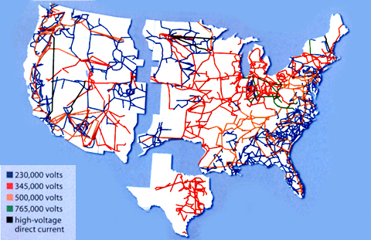
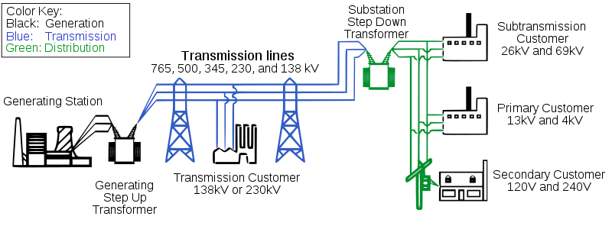
Optimization & Control Theory for Smart Grids
US power grid
Greatest
Engineering
Achievement of
20th century
will require smart revolution
in 21st century

Slide 4
Optimization & Control Theory for Smart Grids

Slide 5
Optimization & Control Theory for Smart Grids

Slide 6
Optimization & Control Theory for Smart Grids
Publications so far (first year of the project):
12. P. Sulc, K. S. Turitsyn, S. Backhaus, and M. Chertkov , Optimization of Reactive Power by Distributed Photovoltaic Generators, submitted to Proceedings of the IEEE, special issue on Smart Grid, arXiv:1008.0878
11. F. Pan, R. Bent, A. Berscheid, and D. Izrealevitz , Locating PHEV Exchange Stations in V2G, accepted IEEE SmartGridComm 2010
10. K. S. Turitsyn, N. Sinitsyn, S. Backhaus, and M. Chertkov, Robust Broadcast-Communication Control of Electric Vehicle Charging, arXiv:1006.0165, accepted IEEE SmartGridComm 2010
9. K. S. Turitsyn, P. Sulc, S. Backhaus, and M. Chertkov , Local Control of Reactive Power by Distributed Photovoltaic Generators, arXiv:1006.0160, accepted IEEE SmartGridComm 2010
8. M. Chertkov, F. Pan and M. Stepanov , Distance to Failure in Power Grids, LA-UR 10-02934
7. K. S. Turitsyn , Statistics of voltage drop in radial distribution circuits: a dynamic programming approach, arXiv:1006.0158, accepted to IEEE SIBIRCON 2010
6. J. Johnson and M. Chertkov , A Majorization-Minimization Approach to Design of Power Transmission Networks, arXiv:1004.2285, accepted 49th IEEE Conference on Decision and Control
5. K. Turitsyn, P. Sulc, S. Backhaus and M. Chertkov, Distributed control of reactive power flow in a radial distribution circuit with high photovoltaic penetration, arxiv:0912.3281 , selected for super-session at IEEE PES General Meeting 2010
4. R. Bent, A. Berscheid, and G. L. Toole, Transmission Network Expansion Planning with Simulation Optimization, Proceedings of the Twenty-Fourth AAAI Conference on Artificial Intelligence (AAAI 2010), July 2010, Atlanta, Georgia.
3. L. Toole, M. Fair, A. Berscheid, and R. Bent , Electric Power Transmission Network Design for Wind Generation in the Western United States: Algorithms, Methodology and Analysis, Proceedings of the 2010 IEEE Power Engineering Society Transmission and Distribution Conference and Exposition (IEEE TD 2010), April 2010, New Orleans, Louisiana.
2. L. Zdeborova, S. Backhaus and M. Chertkov , Message Passing for Integrating and Assessing Renewable Generation in a Redundant Power Grid, presented at HICSS-43, Jan. 2010, arXiv:0909.2358
1. L. Zdeborova, A. Decelle and M. Chertkov , Message Passing for Optimization and Control of Power Grid: Toy Model of Distribution with Ancillary Lines, arXiv:0904.0477, Phys. Rev. E 80 , 046112 (2009)
More info is available at http://cnls.lanl.gov/~chertkov/SmarterGrids

Slide 7
Optimization & Control Theory for Smart Grids:
Design
Grid Design Objective and Challenges
Determine how to best structure the grid to meet the demands of the 21st century
Smart grid devices
Renewable generation
Electric vehicles
Storage
Existing approaches
Don’t account for recent advances in technology
Rely on power flow modeling approximations for the 20th century
Challenges
Intermittent Generation
Large scale (spatial and temporal)
Multi-objective

Slide 8
Optimization & Control Theory for Smart Grids:
Design (Simulation Optimization)
Renewable energy integratation
  The United States plans to have 20% of the nations electric power needs met by wind generation in 2030.
  The grid is not designed to achieve this goal.
Simulation Optimization for Expansion Planning
  Optimization algorithm that is decoupled from the complexities of power flow modeling
    First (that we know of) optimization approach to account for AC power flows
  Scales to large problems, both temporally and spatially (WECC, 30 years)
  Multi-objective
  Integrated resource planning
Bent, Bersheid, and Toole

Slide 9
Optimization & Control Theory for Smart Grids:
Design (Simulation Optimization)
Expansion Decisions
Simulation Optimization
Encapsulate models difficult to represent in a black box (simulation)
Typically used only to evaluate objective function or feasibility
Simulation results inform optimization choices
Algorithm decoupled from the details of how power flow is modeled
Optimization
Our Novelties
Simulation
Power flow behavior

Slide 10
Optimization & Control Theory for Smart Grids:
Design (Simulation Optimization)
0 Discrepancies
1 Discrepancy
2 Discrepancies
3 Discrepancies
Explore expansion solutions according to a construction heuristic
  Up to δ discrepancies of the heuristic
Explore solutions near the heuristic
Generalizes many existing TNEP heuristics
Similar to Limited Discrepancy Search (Harvey and Ginsberg 95)
Simulation flow behavior influences branching decisions

Slide 11
Optimization & Control Theory for Smart Grids:
Design (Simulation Optimization)
Grew Loads and Generation of IEEE RTS-79 by 200-300%
24 buses, 41 transmission corridors
Test the hypothesis that it is easy and cost efficient to modify a DC-based expansion plan
Problem | Total Generation | # Line Overloads | Total Overload
G1 | 8550 MW | 8 | 450.47 MVA
G3 | 8550 MW | Divergent | Divergent
G1 | 8550 MW | 6 | 346.37 MVA
G2 | 8550 MW | 7 | 403.37 MVA
G3 | 8550 MW | 7 | 510.40 MVA
G4 | 8550 MW | 4 | 177.47 MVA
Romero et al. 2005
Feng and Hill 2003

Slide 12
Optimization & Control Theory for Smart Grids:
Design (Simulation Optimization)
Grew Loads and Generation of IEEE RTS-79 by 200-300%
24 buses, 41 transmission corridors
Test the hypothesis that it is easy and cost efficient to modify a DC-based expansion plan
Problem | DC Cost | MU | FD | AP | APA
G1 | 438K | 1072K | 1499K | 1422K | 1517K
G3 | 218K | 631K | 1356K | 1141K | 784K
G1 | 454K | 913K | 1491K | 1908K | 1460K
G2 | 451K | 786K | 1510K | 1842K | 2078K
G3 | 292K | 1729K | 1308K | 988K | 1097K
G4 | 376K | 867K | 1213K | 1833K | 1325K
Romero et al. 2005
Feng and Hill 2003

Slide 13
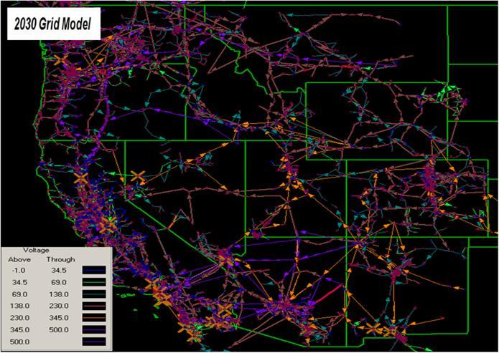
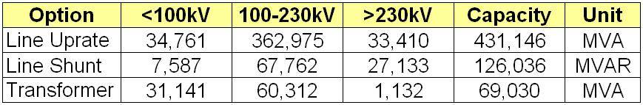
Optimization & Control Theory for Smart Grids:
Design (Simulation Optimization)
Department of Energy generation and demand predictions for 2030.
> 2200 transmission corridors over capacity
> 3300 new power lines in existing and new corridors required to resolve problems (cost of 10.5 billion)

Slide 14
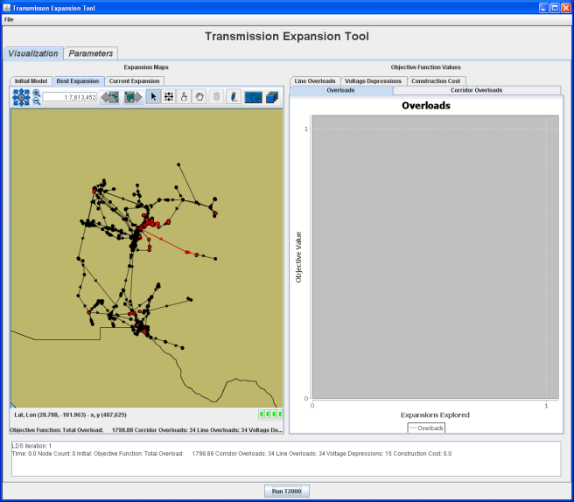
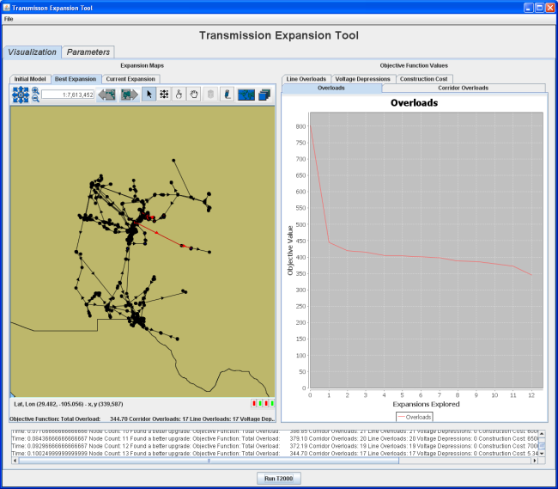

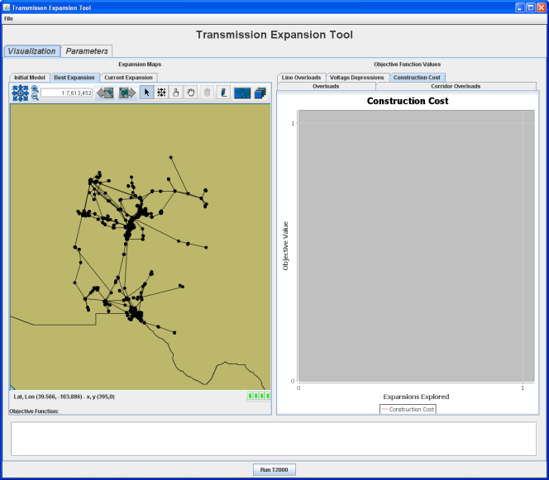
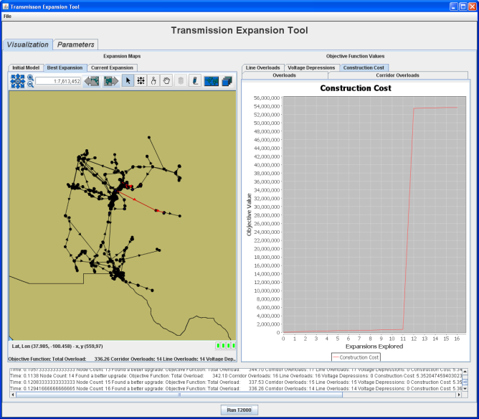

Optimization & Control Theory for Smart Grids:
Design (Simulation Optimization)
Notes:
Here are the snapshots. The top row tracks the overloads and bottom row construction costs (at same point in time) - note that the graph gets rescale in the y direction between the 2nd and 3rd picture for cost... the first jump in cost in the 3rd picture corresponds to the only jump in the 2nd picture.

Slide 15
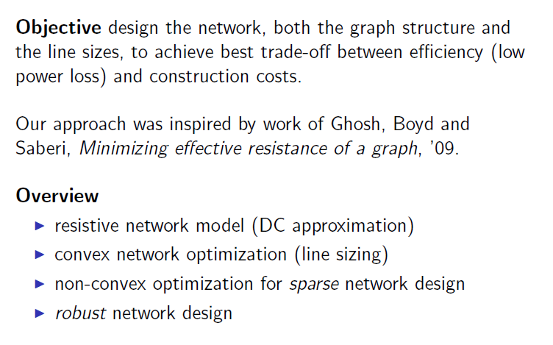

Optimization & Control Theory for Smart Grids:
Design (Majorization-Minimization)
A Majorization-Minimization Approach to Design
of Power Transmission Networks

Slide 16
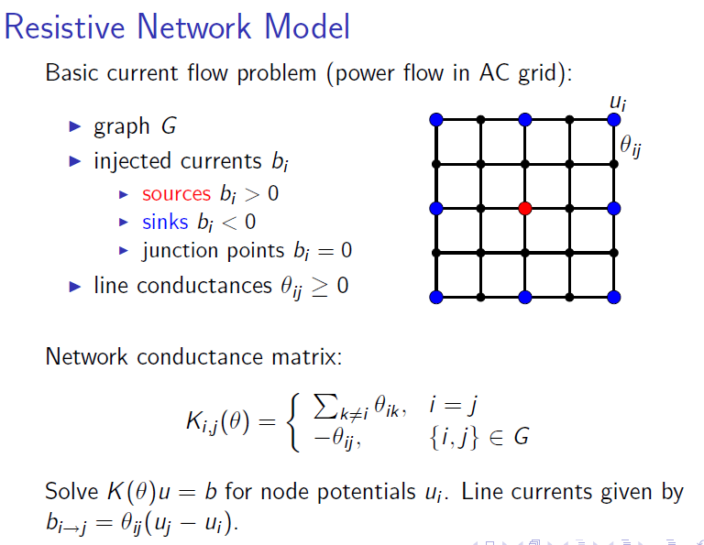
Optimization & Control Theory for Smart Grids:
Design (Majorization-Minimization)

Slide 17
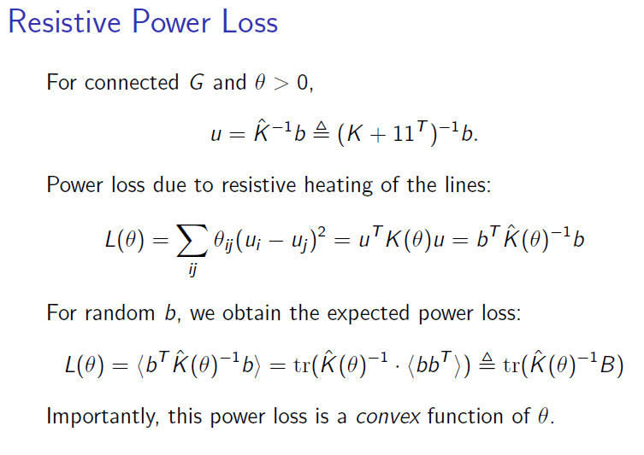
Optimization & Control Theory for Smart Grids:
Design (Majorization-Minimization)

Slide 18
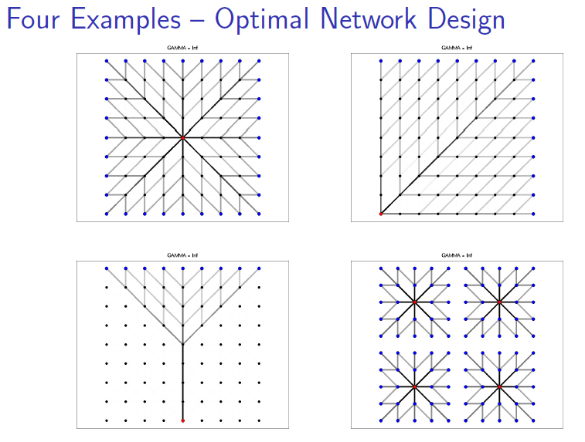
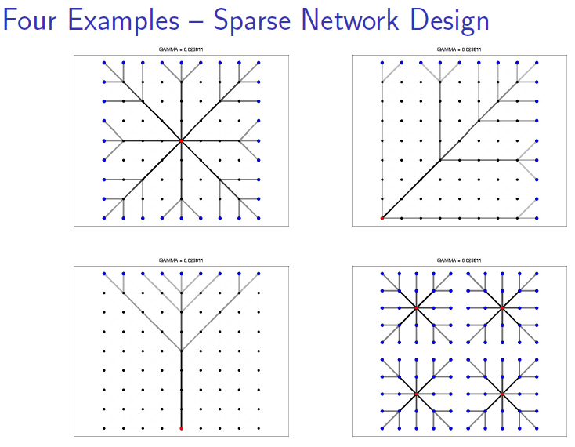
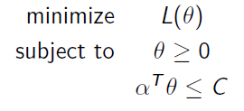
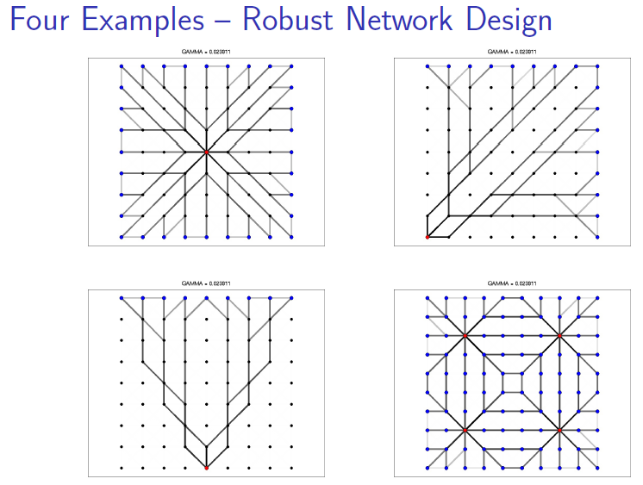

Optimization & Control Theory for Smart Grids:
Design (Majorization-Minimization)
Worth-case dissipation
After removing k-lines
Imposing sparsity +++
Majorization-minimization
heuristics in the spirit of
Candes & Boyd ‘09

Slide 19
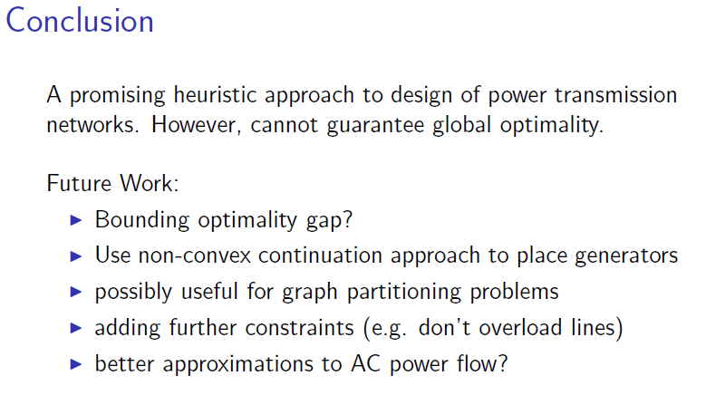
Optimization & Control Theory for Smart Grids:
Design (Majorization-Minimization)

Slide 20
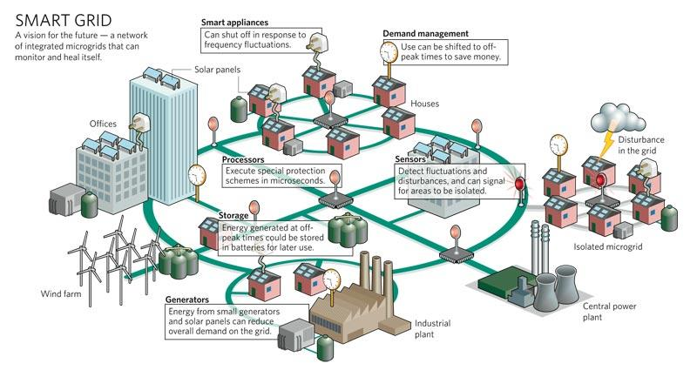

Optimization & Control Theory for Smart Grids:
Design (locating PHEV stations)
Urbanecoist.com
PHEVs are storage devices
Vehicle-to-grid (V2G): valley filling and peak shaving
Understand the claimed benefits through model and simulation
Pan, Bent, Berscheid, and Izraelevitz

Slide 21
Optimization & Control Theory for Smart Grids:
Design [locating PHEV stations]
Locate exchange stations to
  Serve PHEV demands
  Support power grid as power storages
  Connect to power grid without expansion
Similar research:
  Facility location: locate facility to minimize the cost of serving all demands
  Generation expansion: optimally site new generation on a power grid

Slide 22
Optimization & Control Theory for Smart Grids:
Design (locating PHEV stations)
First stage:
Decide on the locations and capacities exchanges stations.
Prior to know the exact battery demand, load, generation capacity (scenario).
A scenario: random variables battery demand, load, renewable generation capacity are realized.
Second stage (recourse action for each scenario):
Distribute batteries for PHEV demand
Discharge batteries for loads

Slide 23





Optimization & Control Theory for Smart Grids:
Design [locating PHEV stations]
First Stage
Second stage objective value
Evaluate x,w at scenario ω

Slide 24




Optimization & Control Theory for Smart Grids:
Design [locating PHEV stations]
At station i, batteries can be allocated for battery demand and for grid
Second Stage
Serving battery demand is models as a Transportation Problem
Traffics are modeled as routes
cost of exchanging battery at station i from route j is
Linearized DC power flow is used for grid
Each exchange stations are linked to a bus and serves as power source
Objective function:
=

Slide 25
Optimization & Control Theory for Smart Grids:
Design (locating PHEV stations)
Miami example
106 stations are optimally placed in V2G system.
Load shedding is reduced.
Unmet battery demand reduced
Location of stations matters.

Slide 26
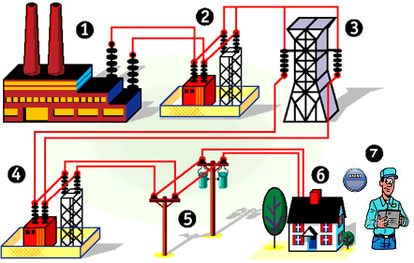
Optimization & Control Theory for Smart Grids:
Control
This part of our control research focuses on the distribution system
Designed to handle peak loads with some margin
Deliver real power from the substation to the loads (one way)
Ensure voltage regulation by control of reactive power (centralized utility control)
We will be asking the grid to do things it was not designed to do

Slide 27
Optimization & Control Theory for Smart Grids:
Control
Need control with new technology
  Electric vehicle charging is a significant new load
  Type 2 charging rates ~ 7-10 kW
  Uncontrolled charging—peak load during evening hours
  Coincident with the existing peak on many residential
  distribution circuits
  Could easily double the peak load resulting in circuit
  overloads
  Need a robust and fair way to control EV charging
High-penetration distributed photovoltaic generation
  Rapidly fluctuating real power flows during partly cloudy days
  Large voltage swings and loss of regulation and power quality
  Existing utility-scale equipment is too slow to compensate
  Latent reactive power capability of the PV inverters can leveraged
  Need a fast, distributed algorithm to dispatch PV inverter
  reactive power
K. Turitsyn
N. Sinitsyn
S. Backhaus
M. Chertkov
P. Sulc
K. Turitsyn
S. Backhaus
M. Chertkov

Slide 28
Optimization & Control Theory for Smart Grids:
Control (of electric vehicle charging)
Robust Broadcast-Communication Control of Electric Vehicle Charging
Distribution circuits with a high penetration of uncontrolled EV charging may…
  experience large EV charging load in the evening…. Resulting in….
  a coincidence with existing peak loads…..Causing…
  potential circuit overloads, breaker operation, equipment damage…..
We seek to control circuit loading by spreading out EV charging via regulation of the rate of random charging start times because…
  it only requires one-way broadcast communication (less expensive), and
  only requires periodic updating of the connection rate, and
  customers treated equally.
Control of circuit loading also allows….
  maximum utilization of existing utility assets, but
  analysis and engineering judgment are required to determine loading limits.
Questions we will try to (at least partially) answer:
  Is broadcast communication sufficient to control EV charging?
  How does the control performance depend on communication rate?
  How many EVs can be integrated into a circuit?

Slide 29
Optimization & Control Theory for Smart Grids:
Control (of electric vehicle charging)
Capacity constraint
Single branch circuit
EVs randomly distributed
May need to consider clustering in multi-branch circuits
Power flow modeled as capacity
No voltage effects
Circuit capacity
Load
N=EV charging capacity
Existing load curve
Additional EV load
4 pm
8 pm
12 am
4 am
8 am
12 pm

Slide 30

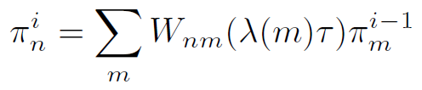
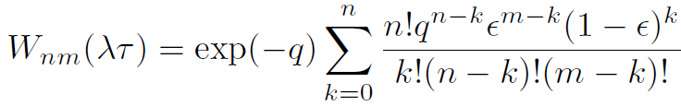

Optimization & Control Theory for Smart Grids:
Control (of electric vehicle charging)
n(t)
λ(t_{i}→t_{i}+τ)
n
nμ(t)
λ(t→t+τ)
Uncontrolled—exit when fully charged
t_{i-1} t_{i} t_{i+1}
Controlled via broadcast
Determine λ(t_{i}→t_{i+1})=F[n(t_{i})] such that E(n) -> N, but π_{n>N} is minimized.
Maximum circuit utilization with small chance of an overload
Poisson processes in each interval τ
Evolution of π_{n} from t_{i-1} to t_{i}
Probability of an overload
Control function λ(n) to cap P_{N}

Slide 31
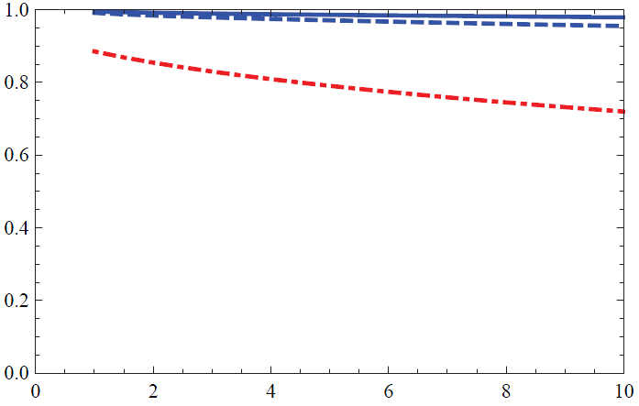
Optimization & Control Theory for Smart Grids:
Control (of electric vehicle charging)
A little bit of communication goes a long way
μτ=10⁻³ [15 sec]
μτ=10⁻² [2.5 min]
N=1000
μτ=0
N=100
[no communication]
n/N
-log₁₀P_{N}
More loads allows for slower communication — smaller fluctuations

Slide 32
Optimization & Control Theory for Smart Grids
Control (of electric vehicle charging)
Conclusions:
In distribution circuits with a high penetration of EVs where uncontrolled charging will lead to coincident peaks and overloads, excellent EV load management can be achieved by:
  Randomization of EV charging start times
  Control of rate of EV connections by one-way broadcast communication.
Quality of control depends on the communication rate, but
  Modest communication rates can achieve high circuit utilization
  Control gets better as the number of EV increases (for a fixed communication rate)
  Subtle aspects to control function when n~N
How many EVs can be integrated into a circuit?
  Requires engineering judgment to balance cost versus performance, but….
  Greater than 90% of excess circuit capacity can be utilized with modest communication requirements.

Slide 33
Optimization & Control Theory for Smart Grids:
Control (of reactive power)
Objectives:
Distribution circuits with a high penetration of PV generation may
  experience rapid changes in cloud cover. Inducing…
  rapid variations in PV generation. Causing…
  reversals of real power flow and potentially large voltage variations
We seek to control the voltage variations by controlling PV-inverter reactive power generation because
  it does not affect the PV owners ability to generate, and
  we can make a significant impact with modest oversizing of inverters
Control of reactive power also allows for reducing distribution circuit losses, but
  voltage regulation and loss reduction are fundamentally competing objectives, and
  analysis and engineering judgment are required to find the appropriate balance
Questions we try to (at least partially) answer:
  Should control be centralized or distributed (i.e. local)?
  What variables should we use as control inputs?
  How to turn those variables into effective control?
  Does the control equitably divide the reactive generation duty?

Slide 34
Optimization & Control Theory for Smart Grids:
Control (of reactive power)
Power flow. Losses & Voltage
0
j -1
j
j +1
n
Competing objectives
Minimize losses → Q_{j}=0
Voltage regulation → Q_{j}=-(r_{j}/x_{j})P_{j}
Rapid reversal of real power flow can cause undesirably large voltage changes
Rapid PV variability cannot be handled by current electro-mechanical systems
Use PV inverters to generate or absorb reactive power to restore voltage regulation
In addition… optimize power flows for minimum dissipation
1.05
Fundamental problem:
import vs export
1.0
Voltage (p.u.)
0.95
Substation
End of line

Slide 35
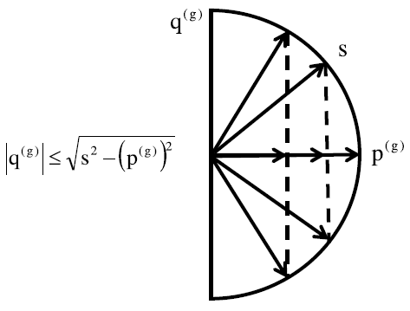
Optimization & Control Theory for Smart Grids:
Control (of reactive power)
Parameters available & limits for control
0
j -1
j
j +1
n
Not available to affect control —but available
(via advanced metering)
for control input
Not available to affect control — but available (via inverter PCC) for control input
Available—minimal impact on customer, extra inverter duty

Slide 36

Optimization & Control Theory for Smart Grids:
Control (of reactive power)
Schemes of Control
Base line (do nothing)
Unity power factor
Proportional Control
(EPRI white paper)
voltage control heuristics
composite control
Hybrid (composite at V=1 built in proportional)
1.0
Voltage p.u.
0.95
1.05

Slide 37
Optimization & Control Theory for Smart Grids:
Control (of reactive power)
Prototypical distribution circuit:
case study
V₀=7.2 kV line-to-neutral
n=250 nodes
Distance between nodes = 200 meters
Line impedance = 0.33 + i 0.38 Ω/km
50% of nodes are PV-enabled with 2 kW maximum generation
Inverter capacity s=2.2 kVA – 10% excess capacity
Import—Heavy cloud cover
p^{c} = uniformly distributed 0-2.5 kW
q^{c} = uniformly distributed 0.2p^{c}-0.3p^{c}
p^{g} = 0 kW
Average import per node = 1.25 kW
Export—Full sun
p^{c} = uniformly distributed 0-1.0 kW
q^{c} = uniformly distributed 0.2p^{c}-0.3p^{c}
p^{g} = 2.0 kW
Average export per node = 0.5 kW
Measures of control performance
δV—maximum voltage deviation in transition from export to import
Average of import and export circuit dissipation relative to “Do Nothing-Base Case”

Slide 38
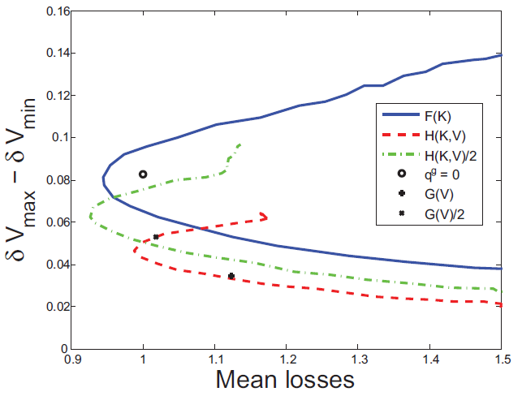
Optimization & Control Theory for Smart Grids:
Control (of reactive power)
Performance of different control schemes
Hybrid scheme
Leverage nodes that already have V_{j}~1.0 p.u. for loss minimization
Provides voltage regulation and loss reduction
K allows for trade between loss and voltage regulation
Scaling factor provides related trades
F(K)
q^{g}=q^{c}
δV
q^{g}=0
H/2
K=1.5
K=1
H(K)
K=0

Slide 39
Optimization & Control Theory for Smart Grids:
Control (of reactive power)
Conclusions:
In high PV penetration distribution circuits where difficult transient conditions will occur, adequate voltage regulation and reduction in circuit dissipation can be achieved by:
  Local control of PV-inverter reactive generation (as opposed to centralized control)
  Moderately oversized PV-inverter capacity (s~1.1 p^{g,max})
Using voltage as the only input variable to the control may lead to increased average circuit dissipation
  Other inputs should be considered such as p^{c}, q^{c}, and p^{g}.
  Blending of schemes that focus on voltage regulation or loss reduction into a hybrid control shows improved performance and allows for simple tuning of the control to different conditions.
Equitable division of reactive generation duty and adequate voltage regulation will be difficult to ensure simultaneously.
  Cap reactive generation capability by enforcing artificial limit given by s~1.1 p^{g,max}

Slide 40
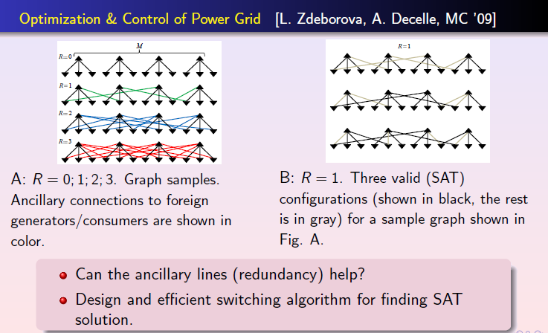
Optimization & Control Theory for Smart Grids:
Control (of switching)

Slide 41
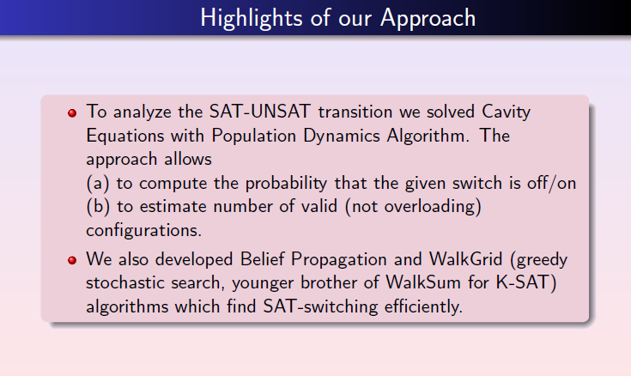
Optimization & Control Theory for Smart Grids:
Control (of switching)

Slide 42
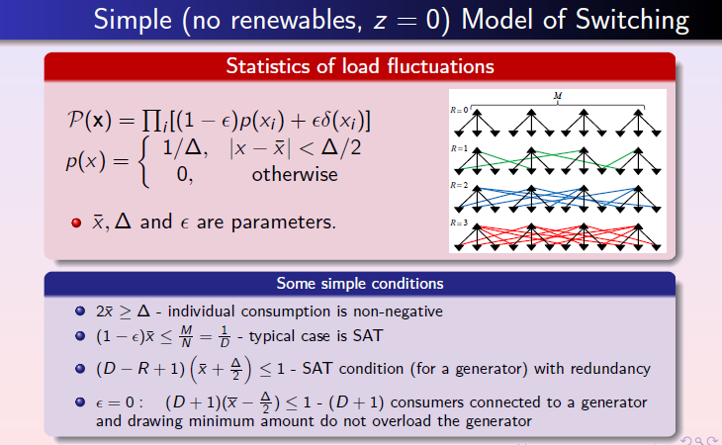
Optimization & Control Theory for Smart Grids:
Control (of switching)

Slide 43
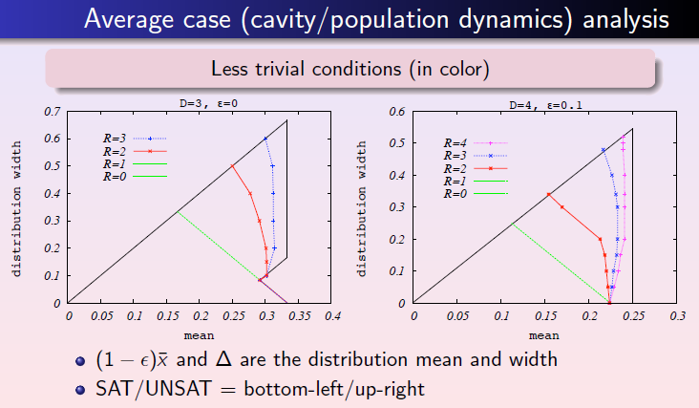
Optimization & Control Theory for Smart Grids:
Control (of switching)

Slide 44
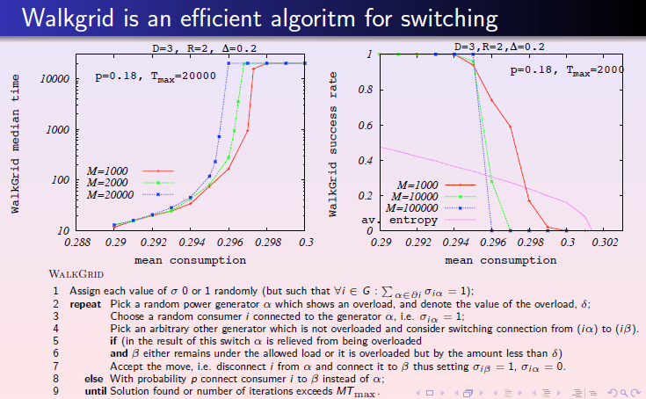
Optimization & Control Theory for Smart Grids:
Control (of switching)

Slide 45
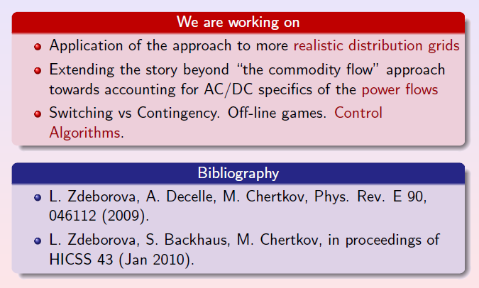
Optimization & Control Theory for Smart Grids:
Control (of switching)

Slide 46
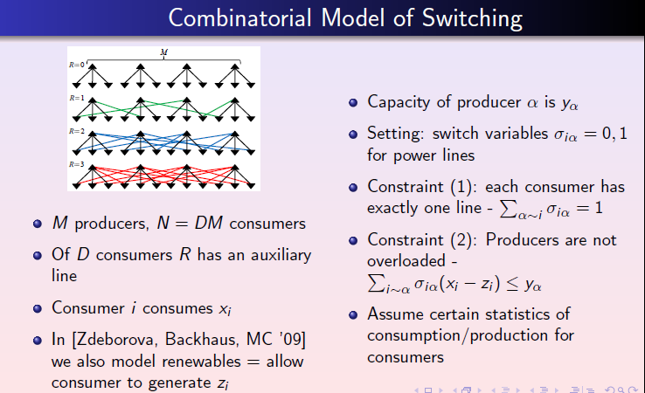
Optimization & Control Theory for Smart Grids:
Control (of switching)

Slide 47
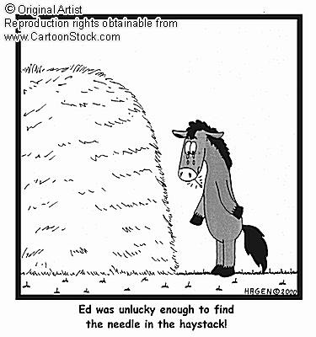
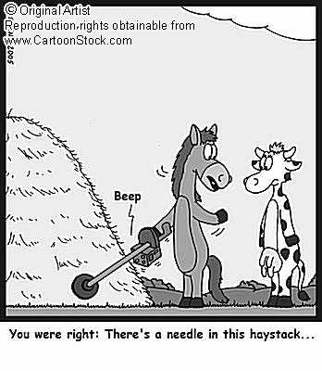
Optimization & Control Theory for Smart Grids:
Stability (distance to failure)
Distance to Failure in Power Grids [Chertkov,Pan,Stepanov]
Normally the grid is SATisfiable
Sometimes failures happen
How to estimate probability of a failure?
How to predict and prevent a failure?
Phase space of possibilities is huge
(finding the needle in the haystack)
Example: The power grid of Guam

Slide 48
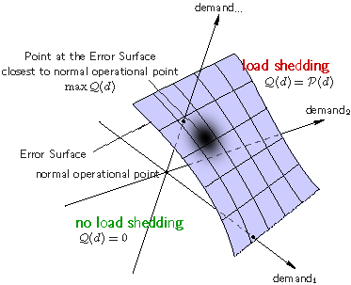
Optimization & Control Theory for Smart Grids:
Stability
Technique to tackle the problem is borrowed from our (LANL) previous
Physics & Error-Correction studies: Instanton Search Algorithm
For any configuration of demand, construct a function Q(d)=0 if no load shedding is required and Q(d)=P(d) [postulated configuration probability] when shedding is unavoidable
Generate a simplex (N+1) of UNSAT points
Use Amoeba-Simplex [Numerical Recipes] to maximize Q(d)
Repeat multiple times (sampling the space of instantons)

Slide 49
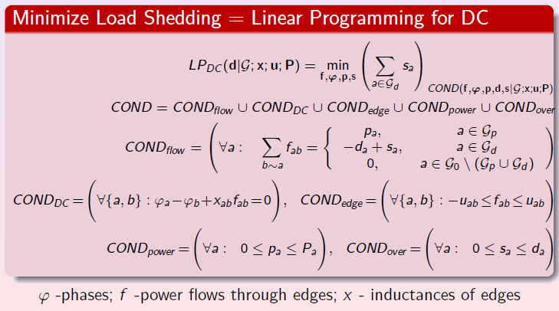
Optimization & Control Theory for Smart Grids
Stability (distance to failure)
no load shedding ⬄

Slide 50
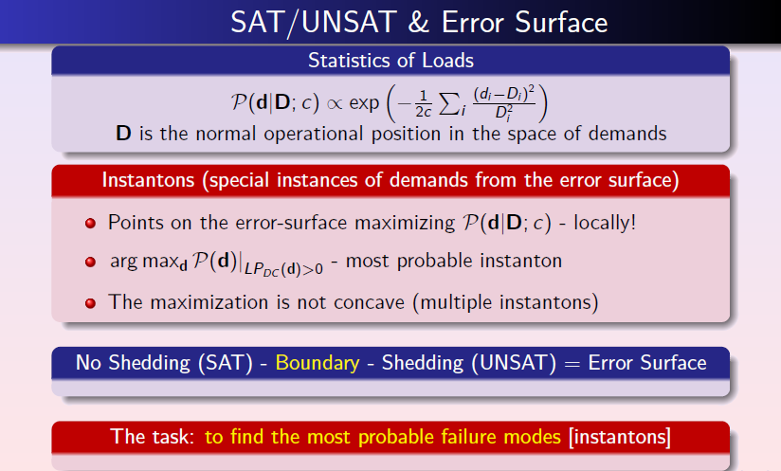
Optimization & Control Theory for Smart Grids
Stability (distance to failure)

Slide 51
Optimization & Control Theory for Smart Grids:
Stability (distance to failure)
Example of Guam:
Data is taken from LANL/ D-division (infrastructure) data-base for a typical day
The instantons (ranked according to their prob. of occurrence) are sparse (localized on nodes connected to highly stressed lines)
The analysis reveals weak points of the grid: unserved nodes, stressed links and generators. Normally, there exists only a handful of the weak points calling for attention.
other examples were also tested

Slide 52
Optimization & Control Theory for Smart Grids:
Stability (distance to failure)
Conclusions and Path Forward
Formulated Load Shedding (SAT/UNSAT) condition as a Linear Programming task based on DC power flow approximation
Analyzed power-grid failure using Error-Surfaces and an instanton description
Instanton-amoeba algorithm was adapted and tested on examples. Good to test, identify (and eventually resolve) hidden problems.
Incorporate other, more realistic measures of network stability, i.e. voltage stability (via AC power flow), voltage collapse and transient stability
Accelerate the instanton-search by utilizing LP-structure of the model. Apply to larger scale problems [e.g. ERCOT driven by renewables]
Reach beyond our first step to explore cutting-edge topics, e.g. fluctuations in renewables, interdiction, optimal switching, cascading events, and avoidance of extreme outages

Slide 53
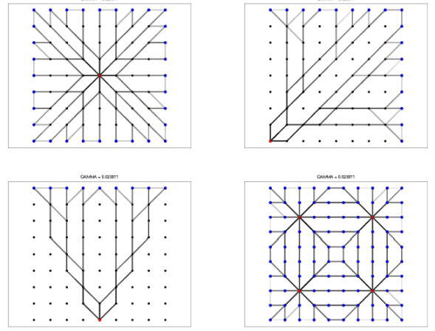
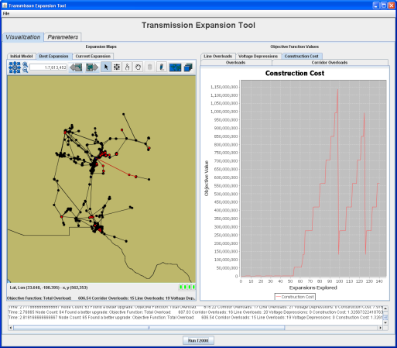
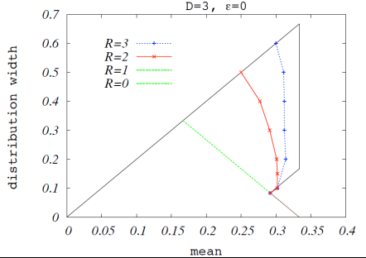
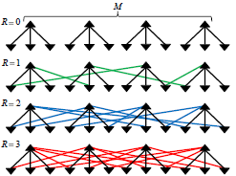
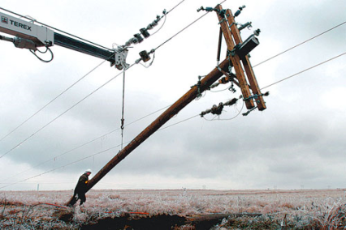
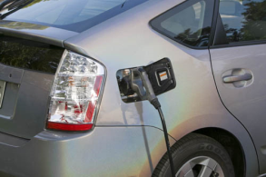
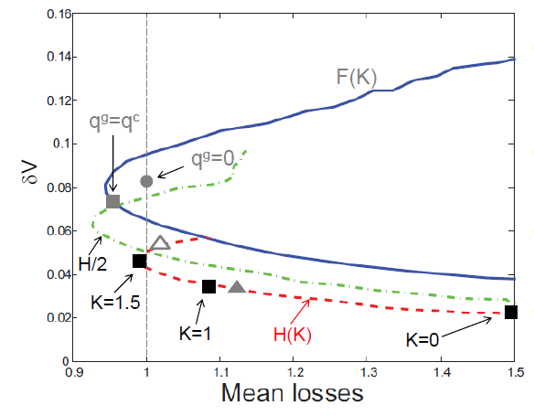
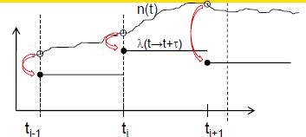
LANL LDRD DR (FY09-11): Optimization & Control Theory for Smart Grids
grid planning
grid control
grid stability
http://cnls.lanl.gov/~chertkov/SmarterGrids/

